Slide 1
Demo 3 – PinPoint App
Thomas More – 15 dec. 2023

Slide 2
Agenda
Action plan – last demo
Scope
Unique friend code
Importing custom floorplans
Location on map
Next Steps

Slide 3
Action plan last demo
Short term – In progress
Research
Localisation method Indoors
Using user location data to display position on map
Sharing location data with others
Using user location to navigate on custom map

Slide 4
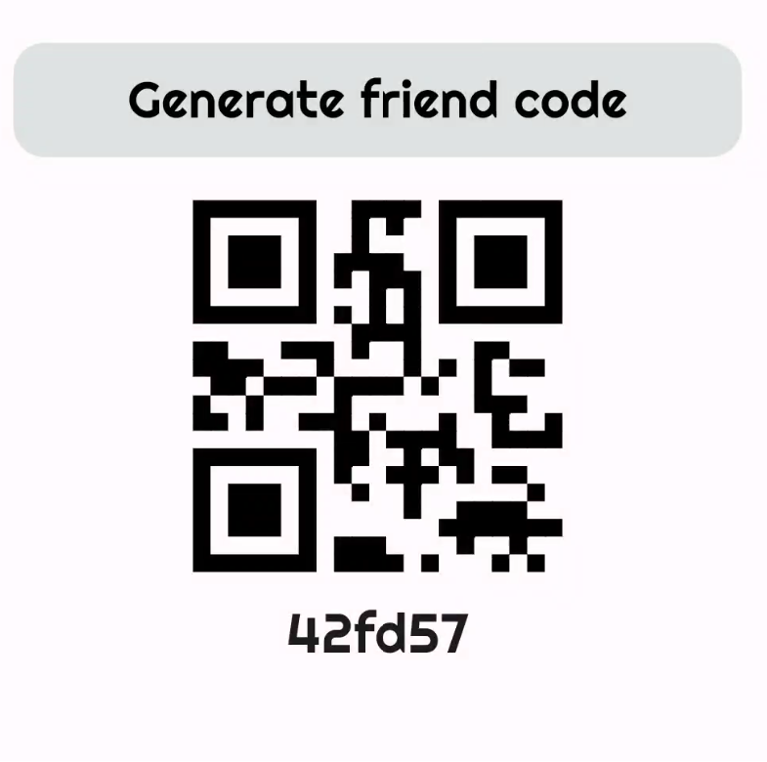
Scope – Unique friend codes
Unique code
Qr-code
Database

Slide 5
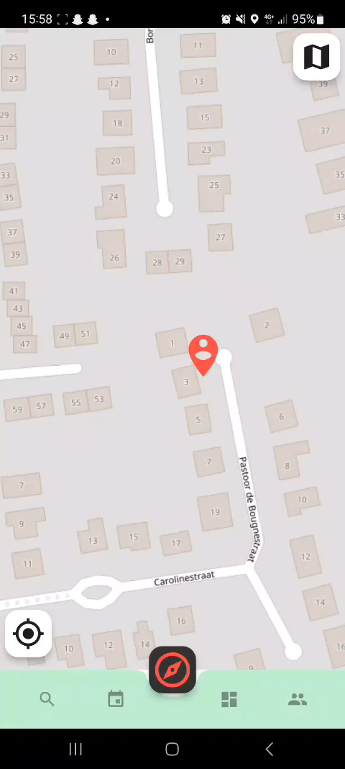
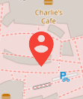
Scope – My Location on Map
Where am I?
Location Marker
Button bottom left
To my location
Zoom level

Slide 6
Scope – Importing custom map
Button top right
Image from gallery or camera
Title
Coordinates

Slide 7
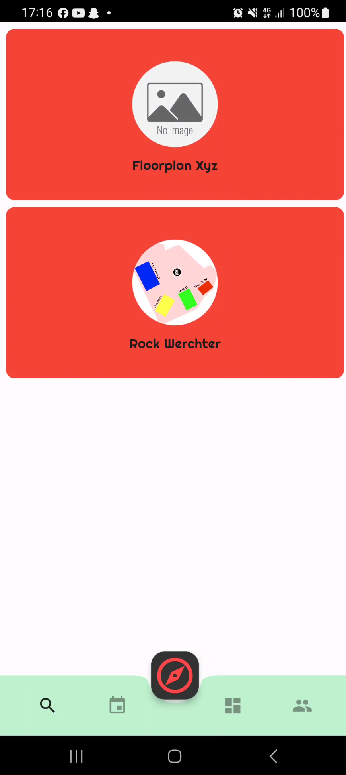
Scope – Events Overview
All events on 1 page
List view
Redirect to map

Slide 8
Next steps
Short term
Showing other users on the map

Slide 9
Thank you
Any questions?

